Slide 1
My Perimeter, Area and Volume Interactive Notebook
Name
Class
Term 3 Semester 2

Slide 2
Contents
Formula Page
Page
Date
Description
2
3

Slide 3
Tasks
24
7
30
Essential Question
Questions
Notes
Summary
18
19

Slide 4
24
7
30
Date
Volume of a Prism
EQ – Describe how the formula for the area of a circle is used to find the volume of a cylinder?
23

Slide 5


Task - Find the area
7mm
12m

Slide 6
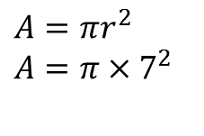
Task - Find the area
$$A=πr^{2}$$
$$A=π×7^{2}$$
7mm
12m

Slide 7
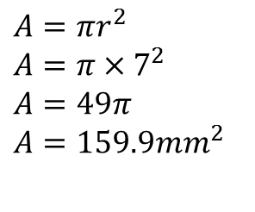
Task - Find the area
$$A=πr^{2}$$
$$A=π×7^{2}$$
$$A=49π$$
$$A=159.9{mm}^{2}$$
7mm
12m

Slide 8
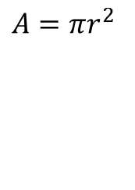
Task - Find the area
$$A=πr^{2}$$
$$A=π×7^{2}$$
$$A=49π$$
$$A=159.9{mm}^{2}$$
7mm
$$A=πr^{2}$$
12m

Slide 9

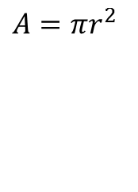
Task - Find the area
$$A=πr^{2}$$
$$A=π×7^{2}$$
$$A=49π$$
$$A=159.9{mm}^{2}$$
7mm
$$A=πr^{2}$$
Radius = $12÷2=6$
12m

Slide 10
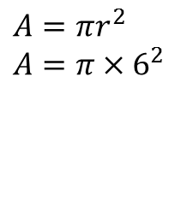
Task - Find the area
$$A=πr^{2}$$
$$A=π×7^{2}$$
$$A=49π$$
$$A=159.9{mm}^{2}$$
7mm
$$A=πr^{2}$$
$$A=π×6^{2}$$
12m

Slide 11
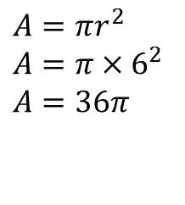
Task - Find the area
$$A=πr^{2}$$
$$A=π×7^{2}$$
$$A=49π$$
$$A=159.9{mm}^{2}$$
7mm
$$A=πr^{2}$$
$$A=π×6^{2}$$
$$A=36π$$
12m

Slide 12
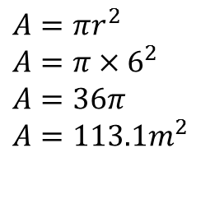
Task - Find the area
$$A=πr^{2}$$
$$A=π×7^{2}$$
$$A=49π$$
$$A=159.9{mm}^{2}$$
7mm
$$A=πr^{2}$$
$$A=π×6^{2}$$
$$A=36π$$
$$A=113.1m^{2}$$
12m

Slide 13

24
7
30
Date
Volume of a Prism
EQ – Describe how the formula for the area of a circle is used to find the volume of a cylinder?
A cylinder is a prism with a circle as the cross section
r
$$l$$
19

Slide 14
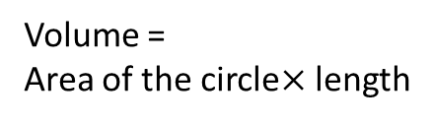
24
7
30
Date
Volume of a Prism
EQ – Describe how the formula for the area of a circle is used to find the volume of a cylinder?
A cylinder is a prism with a circle as the cross section
Volume =
Area of the circle$×$ length
r
$$l$$
19

Slide 15

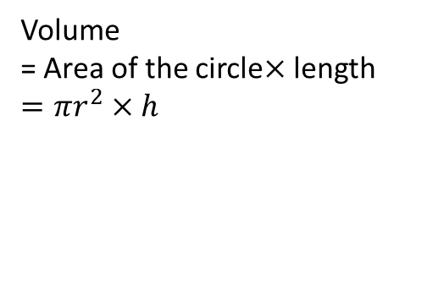
24
7
30
Date
Volume of a Prism
EQ – Describe how the formula for the area of a circle is used to find the volume of a cylinder?
A cylinder is a prism with a circle as the cross section
Volume
= Area of the circle$×$ length
$$=πr^{2}×h$$
r
$$h$$
19

Slide 16
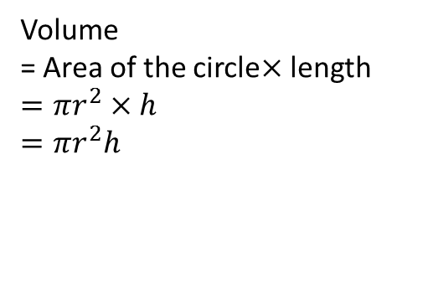
24
7
30
Date
Volume of a Prism
EQ – Describe how the formula for the area of a circle is used to find the volume of a cylinder?
A cylinder is a prism with a circle as the cross section
Volume
= Area of the circle$×$ length
$$=πr^{2}×h$$
$$=πr^{2}h$$
r
$$h$$
10cm
6cm
19

Slide 17
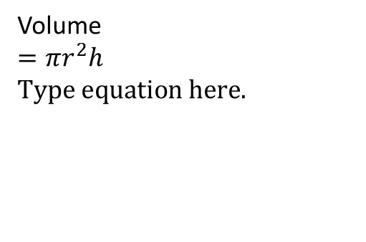
24
7
30
Date
Volume of a Prism
EQ – Describe how the formula for the area of a circle is used to find the volume of a cylinder?
A cylinder is a prism with a circle as the cross section
Volume
= Area of the circle$×$ length
$$=πr^{2}×h$$
$$=πr^{2}h$$
r
$$h$$
Volume
$$=πr^{2}h$$
10cm
6cm
19

Slide 18
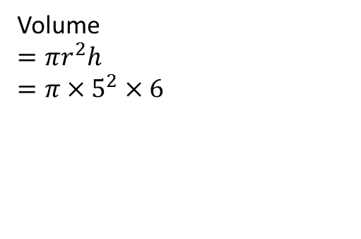
24
7
30
Date
Volume of a Prism
EQ – Describe how the formula for the area of a circle is used to find the volume of a cylinder?
A cylinder is a prism with a circle as the cross section
Volume
= Area of the circle$×$ length
$$=πr^{2}×h$$
$$=πr^{2}h$$
r
$$h$$
Volume
$$=πr^{2}h$$
$$=π×5^{2}×6$$
10cm
6cm
19

Slide 19
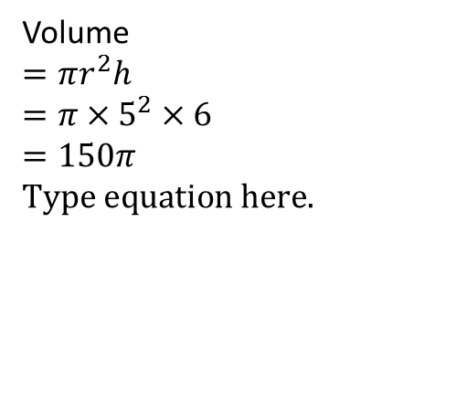
24
7
30
Date
Volume of a Prism
EQ – Describe how the formula for the area of a circle is used to find the volume of a cylinder?
A cylinder is a prism with a circle as the cross section
Volume
= Area of the circle$×$ length
$$=πr^{2}×h$$
$$=πr^{2}h$$
r
$$h$$
Volume
$$=πr^{2}h$$
$$=π×5^{2}×6$$
$$=150π$$
10cm
6cm
19

Slide 20
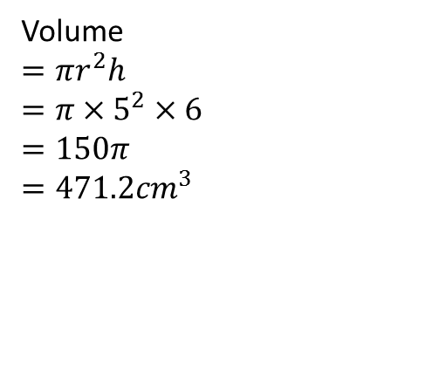
24
7
30
Date
Volume of a Prism
EQ – Describe how the formula for the area of a circle is used to find the volume of a cylinder?
A cylinder is a prism with a circle as the cross section
Volume
= Area of the circle$×$ length
$$=πr^{2}×h$$
$$=πr^{2}h$$
r
$$h$$
Volume
$$=πr^{2}h$$
$$=π×5^{2}×6$$
$$=150π$$
$$=471.2{cm}^{3}$$
10cm
6cm
19

Slide 21
Questions

Slide 22
24
7
30
Date
Volume of a Prism
EQ – Describe how the formula for the area of a circle is used to find the volume of a cylinder?
A cylinder is a prism with a circle as the cross section
What is a cylinder?
Volume
= Area of the circle$×$ length
$$=πr^{2}×h$$
$$=πr^{2}h$$
r
$$h$$
How do I find the volume of a cylinder?
Volume
$$=πr^{2}h$$
$$=π×5^{2}×6$$
$$=150π$$
$$=471.2{cm}^{3}$$
10cm
6cm
19

Slide 23
Notes Review
24, 7 ,30
Date
Title
Essential question
Notes complete
Notes complete with colour and diagrams
Questions completed
Contents page filed in
Formula page filled in

Slide 24
Homework
Review your notes and write a summary answering the essential question.

Slide 25
Plenary
Draw three shapes with a perimeter of 36cm.

